Slide 1

Aspect and Entity Extraction from Opinion Documents
Lei Zhang
Advisor : Bing Liu

Slide 2
Road Map
Introduction
Aspect Extraction
Identify Noun Aspect Implying Opinion
Extract Resource Term
Entity Extraction
Identify Topic Documents from a Collection

Slide 3







What Are Opinion Documents?
  1.Product reviews
  2.Forum discussion posts
  3. Blogs
  4. Tweets
  …
Notes:
With the booming of social media, more and more people are posting their opinions on the Web.

Slide 4

Opinion Mining or Sentiment Analysis
Computational study of people’s opinions, appraisals, attitudes, and emotions from opinion documents

Slide 5


Opinion Mining at Document Level
Sentiment Classification (Pang et al., 2002)
Classify an opinion document (e.g. a movie review) as expressing a positive or negative opinion
Assume:
The document is known to be opinionated
The whole document is the basic information unit

Slide 6
Opinion Mining at Sentence Level
Sentiment classification can be applied to individual sentence (Wiebe and Riloff, 2005)
However, each sentence cannot be assumed to be opinionated in this case
Two steps:
  Subjectivity classification: subjective or objective.
    Objective: e.g., “I bought an iPhone a few days ago.”
    Subjective: e.g., “It is such a nice phone.”
  Sentiment classification: for subjective sentences or clauses, classify positive or negative.
    Positive: e.g., “It is such a nice phone.”
    Negative: e.g., “The screen is bad.”

Slide 7
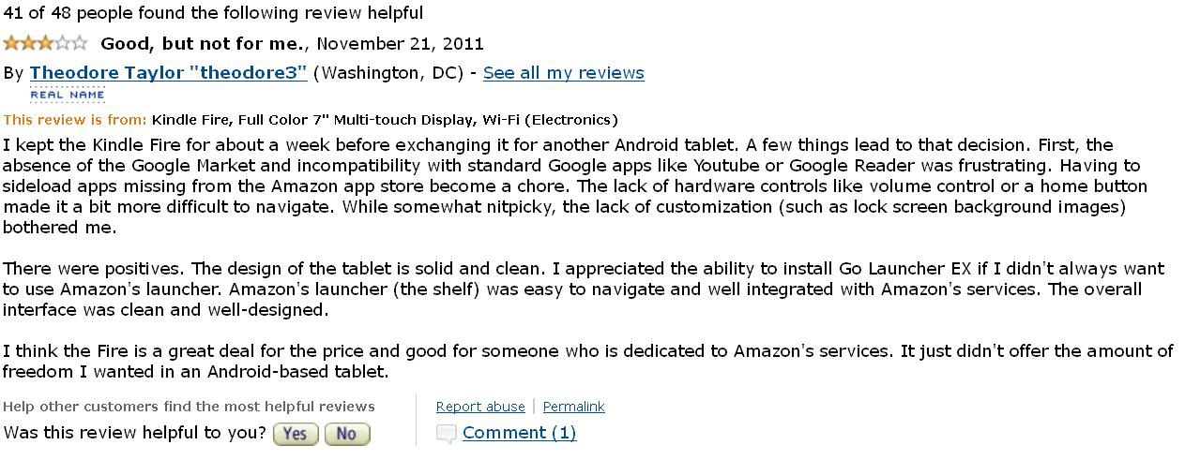
Need Fine Granularity for Opinion Mining
Opinion mining at document level and sentence level is useful in many cases
It still leaves much to be desired!
Negative
Positive

Slide 8
Aspect-based Opinion Mining Model
Extract and summarize people’s opinions expressed on entities or aspects of the entities from opinion documents (Hu and Liu,2004)
Entities
Aspects

Slide 9
What Are Entity and Aspect
An entity can be a product, service, person, organization or event in opinion documents.
An aspect are attributes or components of the entities.
E.g.
“I bought a Sony camera yesterday, and its picture quality is great.”
Sony camera is the entity; picture quality is the product aspect

Slide 10
Opinion Visualization Summary Based on Aspects (Liu, 2011)
+
Summary of reviews of Cell Phone 1
_
Voice
Screen
Battery
Size
Weight
+
Comparison of reviews of
Cell Phone 1
Cell Phone 2
_

Slide 11
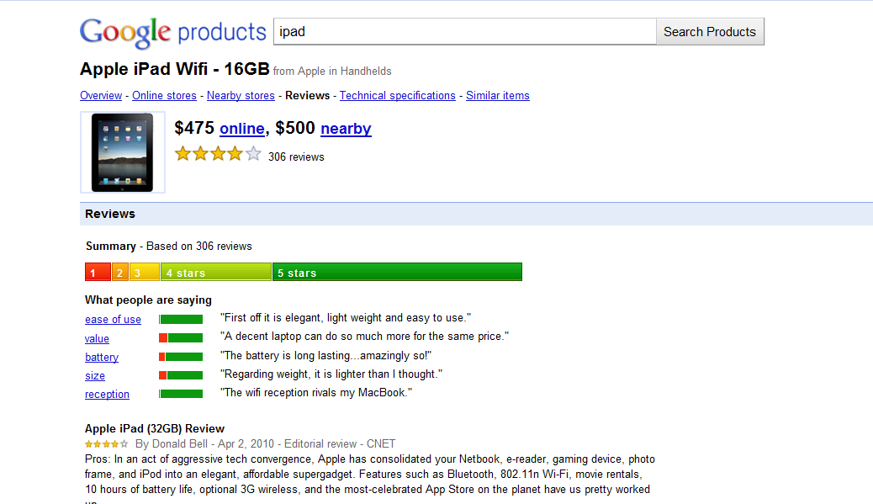
Industry Application
product aspects

Slide 12
Road Map
Introduction
Aspect Extraction
Identify Noun Aspect Implying Opinion
Extract Resource Term
Entity Extraction
Identify Topic Documents from a Collection

Slide 13
Existing Methods
We roughly group existing aspect extraction
methods into three categories
Language rule mining (e.g. dependency grammar, language patterns)
Sequence models (e.g. HMM, CRFs)
Topic modeling and clustering (e.g. PLSA, LDA)

Slide 14
Language Rule Mining
Utilize relations between opinion words (e.g.
“excellent” “awful”) and aspects
e.g. “This camera takes great picture.”
Opinion words are publicly available
The relations can be found by sequence rule mining (Hu and Liu, 2004) or dependency grammar (Zhuang, 2006; Qiu et al.,2011)

Slide 15
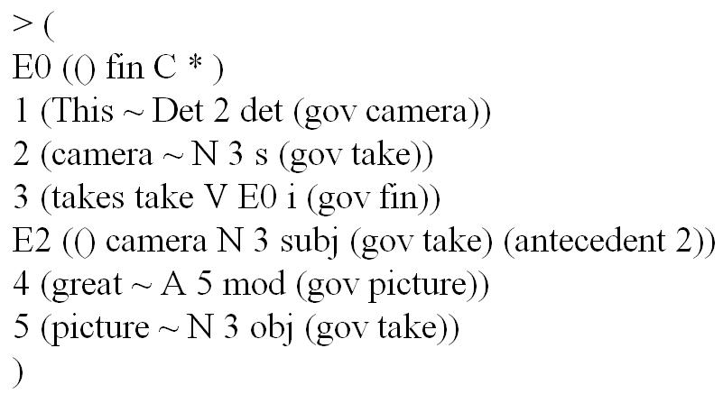
Dependency Grammar
e.g. “This camera takes great picture.”
Word dependency relations (parsed by MiniPar)
Dependency relation
Aspect
Opinion word
Notes:
Words in a sentence are linked to each other by a certain dependency relation

Slide 16
Language Rule Mining
State-of-art approach: double propagation (Qiu et al., 2011) .
(1) Bootstrap using a set of seed opinion words (no aspect input).
(2) Extract aspects and also domain-dependent opinion words
Advantages
domain-independent, unsupervised
Disadvantages
noise for large corpora; low recall for small corpora

Slide 17
Sequence Models
Deem aspect extraction as a sequence labeling task, since product aspect, entity and opinion expression are often interdependent and occur at a sequence in a sentence
HMM (Hidden Markov Model) and CRF (Conditional Random Fields) are often applied.
(Jin et al.,2009;Jakob and Gurevych,2010)
Disadvantages:
domain-dependent, supervised needing manual labeling.

Slide 18
Topic Modeling and Clustering
Exploit word occurrence information to capture latent topics in corpora. (topic = aspect)
PLSA(Probabilistic Latent Semantic Analysis) and LDA(Latent Dirichlet Allocation) (Titov and McDonald,2008) e.g. in hotel reviews, topics as follows
staff, desk,
English…
walk, bus,
station,
Metro…
Topic: service
Topic: location
Advantages
unsupervised, group similar aspects together
Disadvantages
cannot find fine-grained or precise aspects.

Slide 19
Proposed Method
Shortcomings of double propagation (Qiu et al.,2011)
(1) low recall for small corpora
e.g. “There is a screen scratch on the phone”
(2) noise for large corpora
e.g. “entire” “current” (not opinion words)
To tackle these problems:
(1) In addition to applying dependency grammar, use language patterns to increase recall
(2) Rank the extracted aspects and rank noise low.

Slide 20
Language Patterns
Part-whole pattern
Indicate one object is part of another object. indicator for aspects (“part”) if the class concept word (“whole”) is known
(1) phrase pattern (NP: noun CP: concept word)
NP + prep + CP (e.g. battery of the camera)
CP + with + NP (e.g. mattress with a cover)
NP CP or CP NP (e.g. mattress pad)
(2) sentence pattern
CP + verb + NP (e.g. “the phone has a big screen”)
“no” pattern
a short pattern frequently used in opinion documents (e.g. “no noise”, “no indentation”)

Slide 21
Rank Extracted Aspects
Aspect importance. If an aspect candidate is correct and important, it should be ranked high. Otherwise, it should be ranked low.
Two factors affecting aspect importance
(1) Aspect relevance: how possible an aspect candidate is a correct aspect
(2) Aspect frequency: an aspect is important, if it appears frequently in opinion documents.
Notes:
inevitably

Slide 22
Aspect Relevance
Observations:
Mutual enforcement relations between opinion words, part-whole pattern, “no” pattern and aspects.
E.g.
If an adjective modifies many correct aspects, it is highly possible to be a good opinion word.
If an aspect candidate can be extracted by many opinion words, part-whole patterns, or “no” pattern, it is also highly likely to be a correct aspect.

Slide 23
Use HITS to Measure Aspect Relevance
Opinion words,
Part-whole pattern,
“no” pattern
Aspects
Hubs
Authorities
Web page ranking algorithm (HITS) can be applied. If an aspect candidate has high-ranked authority score, it should be a correct aspect.

Slide 24
Aspect Ranking
The final ranking score considering aspect relevance and aspect frequency
S = S(a) * log (freq(a))
freq(a) is the frequency count of aspect a. and S(a) is the authority score of aspect a.

Slide 25
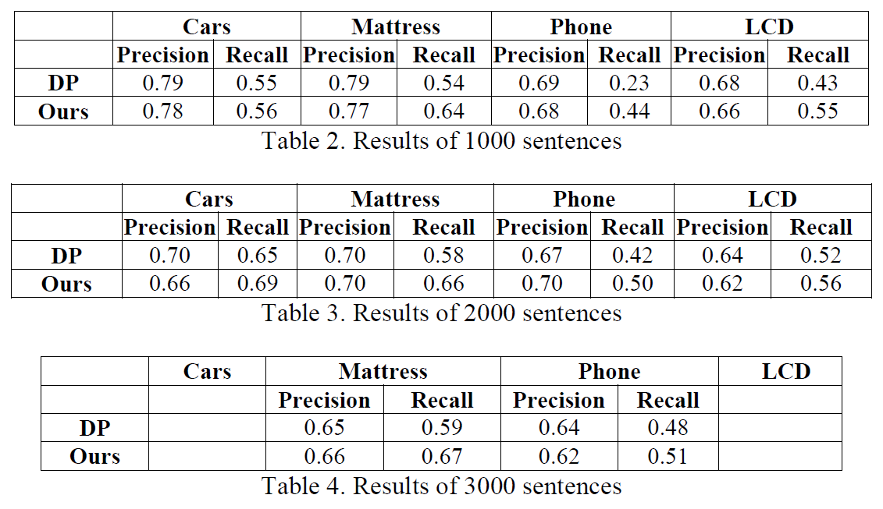
Experimental Results
Results with different corpus size
Better recall than double propagation

Slide 26
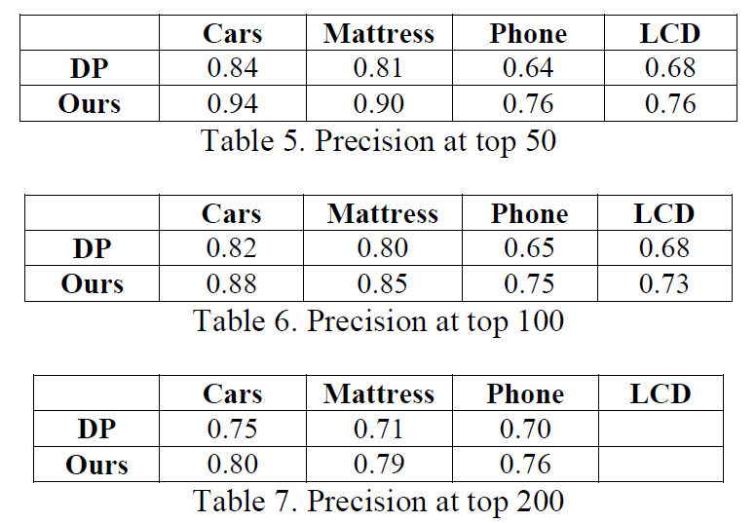
Experimental Results
Better than that ranked by pure frequency

Slide 27
Road Map
Introduction
Aspect Extraction
Identify Noun Aspect Implying Opinion
Extract Resource Term
Entity Extraction
Identify Topic Documents from a Collection

Slide 28
Introduction
E.g. “Within a month, a valley formed in the middle of the mattress.”
“valley” indicates the quality of the mattress (a product aspect) and also implies a negative opinion.
These noun aspects are not subjective but objective. Their involved sentences are also objective sentences but imply positive or negative opinions.
Notes:
It is a new problem.

Slide 29
Proposed Method
Step 1: Candidate extraction
Identified by the its surrounding opinion context.
If a noun aspect occurs in negative (respectively positive) opinion contexts significantly more frequently than in positive (or negative) opinion contexts, we can infer that its implicit polarity is negative (or positive).
Sentiment analysis method is used to determine opinion context. Statistical test is used to test the significance.
Notes:
Determine candidates by checking the percentage of either positive-opinionated sentences or negative-opinionated sentences among all opinionated sentences.
(test for population proportion)

Slide 30
Proposed Method
Step 2: Pruning
Prunes non-opinionated candidates
If a noun aspect is directly modified by both positive and negative opinion words, it is unlikely to be an opinionated product aspect.
E.g., people would not say “good valley”
Dependency parser is used to find the modifying relation between opinion words and aspects.

Slide 31
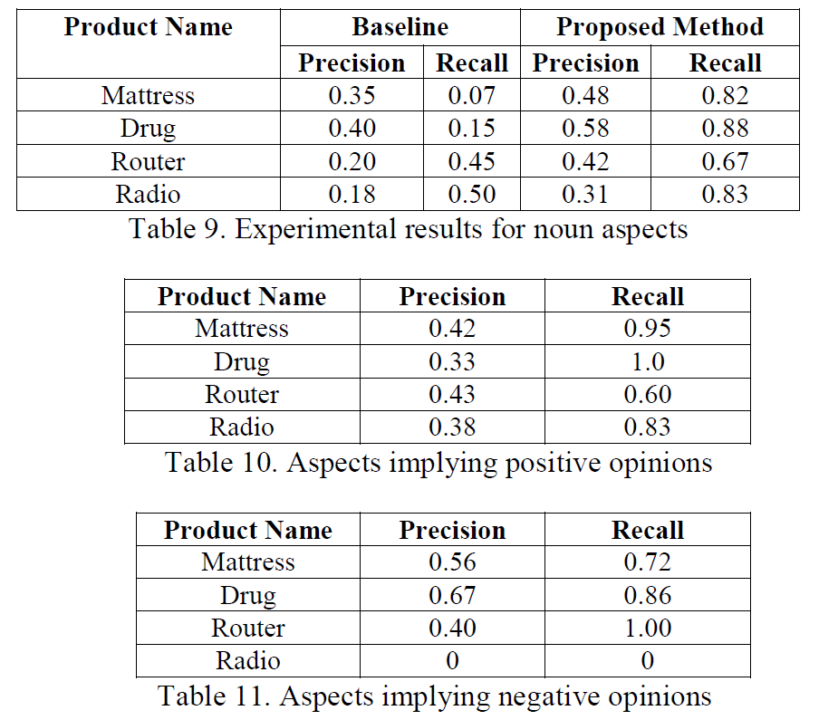
Experimental Results

Slide 32
Road Map
Introduction
Aspect Extraction
Identify Noun Aspect Implying Opinion
Extract Resource Term
Entity Extraction
Identify Topic Documents from a Collection

Slide 33
Introduction
Resource term: a type of words and phrases that do not bear sentiments on their own, but when they appear in some particular contexts, they imply positive or negative opinions.
Positive ← consume no or little resource
| consume less resource
Negative ← consume a large quantity of resource
| consume more resource
“This laptop needs a lot of battery power”

Slide 34
Resource Term Triple
Observations:
The sentiment expressed in a sentence about resource usage is often determined by the triple
(verb, quantifier, noun_term),
where noun_term is a noun or a noun phrase
e.g.
“This car uses a lot of gas.”
Can we identify the resource terms in a domain corpus based on the (verb, noun) relations in triple ?

Slide 35
Our Idea
Triples
“use”
“consume”…
“water”
“money”
……
Global resource usage verbs
Global resource term seeds
Find global resource usage verbs first
Use such verbs to find the resource terms in each specific domains
Notes:
It is not trivial to identify resource terms in each application domain.

Slide 36
Step 1: Identify Global Resource Verbs
Global resource verbs : express resource usage of many different resources, e.g., “use” and “consume”.
1. The more diverse the resource term seeds that a verb can modify, the more likely it is a good global resource verb.
2. The more verbs a resource term seed is associated with, the more likely it is a real resource term.
Verb candidates and resource term seeds forms bipartite graph. HITS algorithm can be applied because of their mutual enforcement relations

Slide 37
Step 2: Discovering Resource Terms in a Domain Corpus
With global resource usage verbs, how to find resource terms in a specific domain corpus.
Still using HITS algorithm? NO!
A verb modifying multiple noun terms does not necessarily indicate that the verb is a resource usage verb. e.g. verb “get”
it is not always the case that if a noun term is modified by many verbs, it is a resource term.
e.g. noun “car” for the car domain
Notes:
A verb modifying multiple noun terms does not necessarily indicate that the verb is a resource usage verb. For example, it could be a general verb like “get”. Also, as mentioned earlier, it is not always the case that if a noun term is modified by many verbs, it is a resource term. For example, it could be a topic word like “car” for the car domain.

Slide 38
Step 2: Discovering Resource Terms in a Domain Corpus (Continue)
Observations:
1. If a noun term is frequently associated with a verb (including quantifiers), the noun term is more likely to be a real resource term. (e.g. “spend a lot of money”, “spend less money”, “spend much money” …)
2. If a verb is frequently associated with a noun term (including quantifiers), it is more likely to be a real resource verb.
Take frequency into consideration and turn the frequency into a probability and make use of the expected value to compute scores for the verbs and noun terms

Slide 39
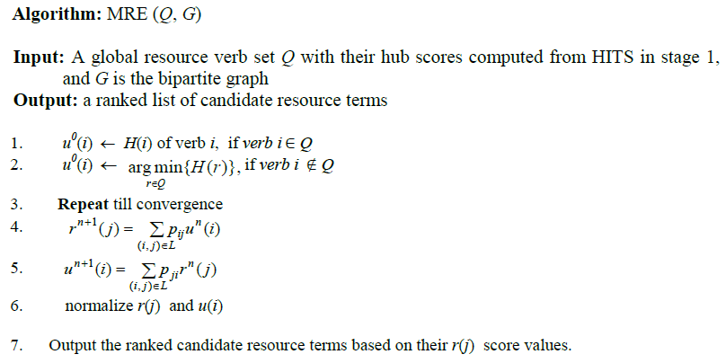
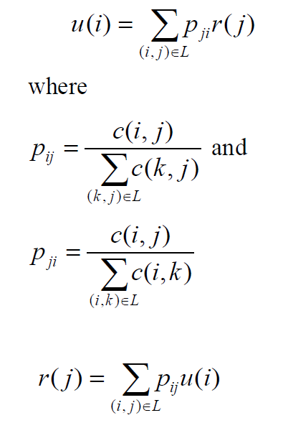
MER(Mutual Reinforcement based on Expected Values) Algorithm
p_{ji} is the probability of link (i, j) among all links from different nouns j to a verb i.
p_{ij} is the probability of link (i, j) among all links from different verbs i to a noun j.
Notes:
c(i, j) is the frequency count of the link (i, j) in our corpus. p_{ij} is thus the probability of link (i, j) among all links from different verbs i to a noun j. p_{ji} is the probability of link (i, j) among all links from different nouns j to a verb i.

Slide 40
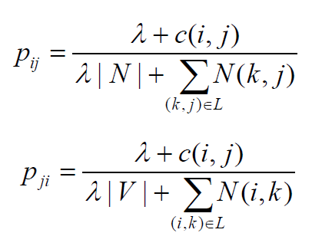
Smoothing the Probabilities
The probabilities of verbs or nouns are not reliable due to limited data.
Lidstone smoothing (Lidstone, 1920)

Slide 41
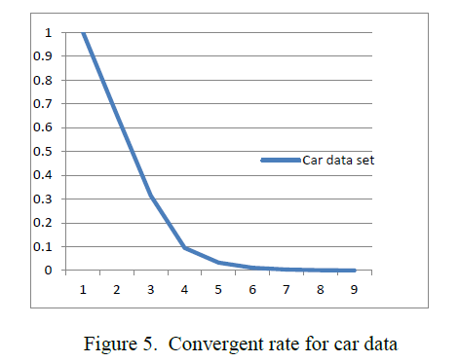
Algorithm Convergence

Slide 42
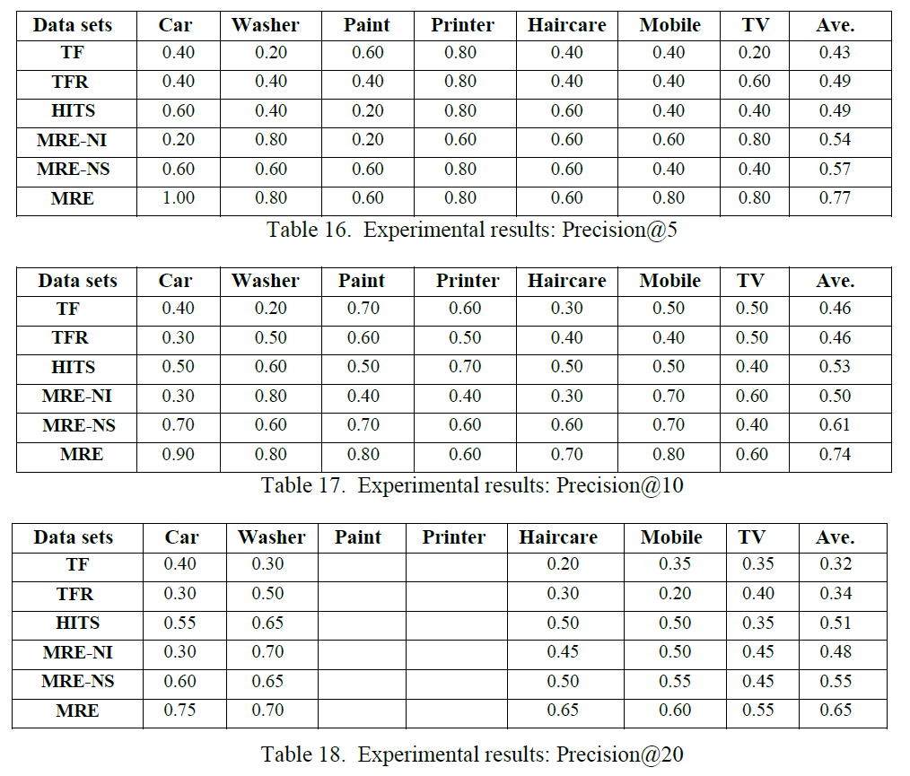
Experimental Results
Better ranking results with a large margin

Slide 43
Road Map
Introduction
Aspect Extraction
Identify Noun Aspect Implying Opinion
Extract Resource Term
Entity Extraction
Identify Topic Documents from a Collection

Slide 44
Entity Extraction
Without knowing the entity, the piece of opinion has little value.
In opinion mining, users want to know the competitors in the market. This is the first step to understand the competitive landscape from opinion documents.
I want to know opinions about competing cars for
Ford Focus

Slide 45
Set Expansion Problem
To find competing entities, the extracted entities must be relevant, i.e., they must be of the same class/type as the user provided entities.
The user can only provide a few names because there are so many different brands and models.
The problem is a set expansion problem, which expands a set of given seed entities. It is a classification problem. However, in practice, the problem is often solved as a ranking problem.

Slide 46
Distributional Similarity
Distributional similarity is classical method for set expansion problem.
It compares the similarity of the word distribution of the surround words of a candidate entity and the seed entities, and then ranking the candidate entities based on the similarity values.
Our result shows this approach is inaccurate.

Slide 47
PU Learning Model
Positive and Unlabeled (PU) Learning. It is a two-class classification model.
Given a set P of positive examples of a particular class and a set U of unlabeled examples (containing hidden positive and negative cases), a classifier is built using P and U for classifying the data in U or future test cases.
The set expansion problem can be mapped into PU learning exactly.

Slide 48
S-EM Algorithm
S-EM is a reprentative algorithm under PU learning model.
It is based on Naïve Bayes (NB) classification and Expectation Maximum (EM) algorithm.
Main idea: use spy technique to identify some reliable negatives (RN) from the unlabeled set U, and then use an EM algorithm to learn from P, RN and U-RN .
We use classification score to rank entities.

Slide 49
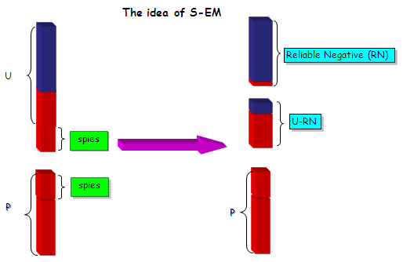
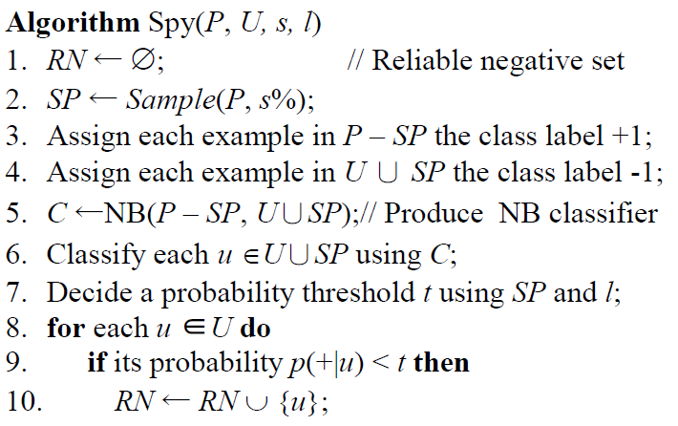
Idea of S-EM

Slide 50
Data Input for S-EM
Positive sets and unlabeled sets:
For seed s , each occurrence in the corpus forms a vector as a positive example in P. The vector is formed based on context of the seed mention.
For candidate d ∈ D (all candidates), each occurrence also forms a vector as an unlabeled example in U.
Context: set of surrounding words within a windows of size w. (we set w = 3 )
Notes:
The components in the feature vectors are term frequencies for S-EM

Slide 51
Candidate Entity Ranking
Each unique candidate entity may generate multiple feature vectors in S-EM, we need to decide a single score to present the entity score ( we choose median value).
The final ranking score for an candidate entity
M_{d} is the median value for all feature vector scores of candidate entity
n is the candidate entity’s frequency
fs(d) is the final ranking score for the candidate entity
Notes:
It is highly desirable to rank those correct and frequent entities at the top

Slide 52
Bayesian Sets
Bayesian Sets (BS) is based on Bayesian inference and was designed specifically for the set expansion problem.
It learns from a seeds set (i.e., a positive set P) and an unlabeled candidate set U.
It was not designed as a PU learning method, it has similar characteristics and produce similar result.

Slide 53
Bayesian Sets
Given and , we aim to rank the elements of by how well they would “fit into” a set which includes (queries or seeds)
Define a score for each
From Bayes rule, the score can be re-written as:

Slide 54

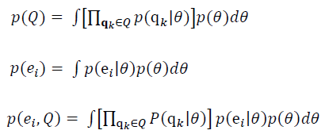

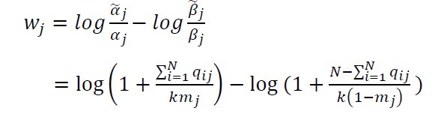
Bayesian Sets
For each entity e_{i} in D, we compute
P(θ) is a prior on model parameters
N is the number of items in the seed set; q_{ij} the value of feature j for seed q_{i} ; m_{j} is the mean of feature j of all possible entities

Slide 55
How to Apply Bayesian Sets
Two aspects.
(1) Feature identification:
A set of features to represent each entity.
(2) Data generation:
(a) multiple feature vector for an entity
(b) Feature reweighting
(c) Candidate entity ranking

Slide 56
Two Types of Features for an Entity
Like a typical learning algorithm, we design a set of features for learning.
Entity Word Features (EWF): Makeup and characteristics of a word. This set of features is completely domain independent.
E.g
EWF1: Only the first letter in the word is capitalized, e.g., Sony.
EWF2: Every letter in the word is capitalized, e.g., IBM.

Slide 57
Surrounding Word Features
Surrounding Word Features (SWF): words on the left or right of the candidate entity.
We define the six syntactic templates for feature extraction. The extracted features are specific words or phrases.
E.g.
Template 1: Left first verb of EN in the text window
e.g. “I have bought this EN LCD yesterday”, “bought” is extracted as a feature as it is the first verb on the left of EN.

Slide 58
Data Generation
Because for each candidate entity, there are several feature vector is generated. It causes the problem of feature sparseness.
We proposed two techniques to deal with the problem:
(1) Feature reweighting
(2) Entity ranking

Slide 59

Feature Reweighting
Recall the score for an entity
N is the number of items in the seed set.
q_{ij} the value of feature j for seed q_{i} ;
m_{j} is the mean of feature j of all possible entities
In order to make a positive contribution to the final score of entity e, w_{j} > 0.
Then we can get
the seed data mean must be greater than the candidate data mean on feature j.

Slide 60
Feature Reweighting (continue)
Unfortunately, due to the idiosyncrasy of the data, There are many high-quality features, whose seed data mean may be even less than the candidate data mean.
E.g. in drug data set, “prescribe” can be a left first verb for an entity. It is a very good entity feature.
“Prescribe EN/NNP” (EN: entity; NNP: POS tag) strongly suggests that EN is a drug. However, the problem is that the mean of this feature in the seed set is 0.024 which is less than its candidate set mean 0.025

Slide 61


Feature Reweighting
In order to fully utilize all features. We change original m_{j} to by multiplying a scaling factor to force all feature weights w_{j} > 0:
We lower the candidate data mean intentionally so that all the features found from the seed data can be utilized. we let to be greater than N for all features j.
t can be determined since N is a constant.

Slide 62
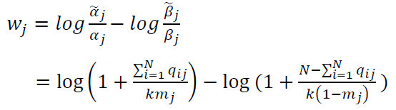
Identifying High-quality Features
Does not consider feature quality
E.g., features A and B, which have the same feature frequency in the seed data and thus the same mean, they should have the same feature weight.
However, for feature A, all feature count may come from only one entity in the seed set, but for feature B, the feature counts are from four different entities in the seed set.
B is a better feature than A, because it is shared by or associated with more entities.

Slide 63
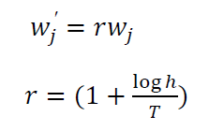
Identifying High-quality Features
Boost weight for high-quality features
r is used to represent feature quality for feature j. h is the number of unique entities that have jth feature. T is the total number of entities in the seed set.

Slide 64

Candidate Entity Ranking
Each unique candidate entity may generate multiple feature vectors. we need to decide a single score to present the entity score ( we choose median value).
The final ranking score for a candidate entity
M_{d} is the median value for all feature vector scores of candidate entity
n is the candidate entity’s frequency
fs(d) is the final score for the candidate entity

Slide 65
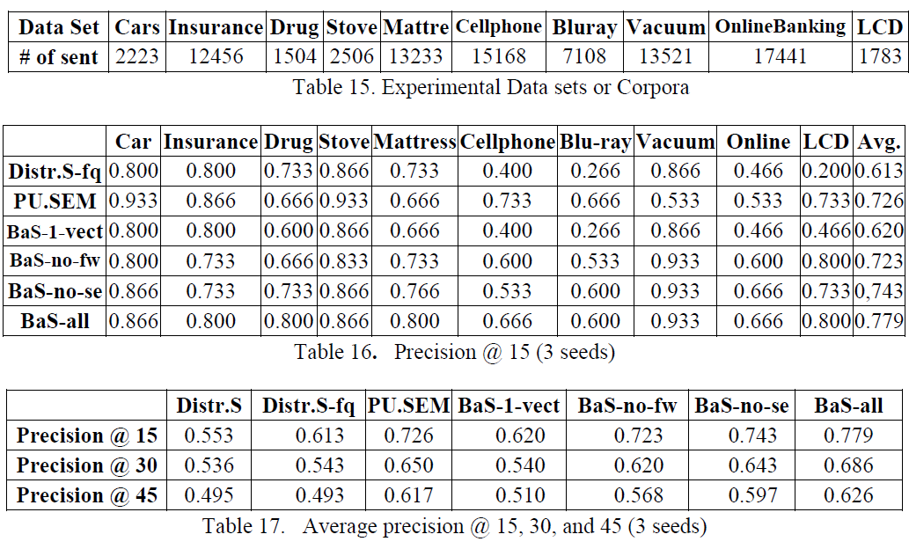
Experiment Results
S-EM and Bayesian Sets have much better results than baseline methods. Bayesian Sets is even better with feature boosting.

Slide 66
Road Map
Introduction
Aspect Extraction
Identify Noun Aspect Implying Opinion
Extract Resource Term
Entity Extraction
Identify Topic Documents from a Collection

Slide 67
Introduction
In many Web applications, the documents are not well categorized because the user does not know what the future tasks will be.
We have to find all opinion documents related to the type of products from data store, which contains a mixed set of documents from a large number of topics.

Slide 68
Keyword Search Method
The user issues some keywords to retrieve the relevant documents.
Low precision
E.g., if we use the word “TV” to collect relevant reviews, we may retrieve many irrelevant documents such as “PS3” and “home theater” because they can contain the word “TV”.
Low recall
Many documents that do not contain the word “TV” may be TV related documents.
Notes:
The reason for low precision is that a document that contains the keywords is not necessarily relevant.

Slide 69
Text Classification Method
We can model the problem as a traditional text classification problem The user manually labels some relevant and irrelevant documents for training.
Disadvantage
Manual labeling is labor-intensive and time-consuming, even impractical in practice.

Slide 70
Text Clustering
Group text documents into different categories.
It can also be employed as a classifier. We can classify a test document to a cluster which is closest to it.
Disadvantage
Not accurate, cluster(topic) number is unknown

Slide 71
PU Learning Can Model Our Problem Well
PU Learning (learning from positive and unlabeled examples)
A set of labeled positive examples and a set of unlabeled examples, but no labeled negative examples.
S-EM is the representative algorithm and
can be applied directly given initial postive examples.
However, S-EM does not produce satisfactory results.
Notes:
Given a keyword q of a topic T of interest and a mixed set of unlabeled documents D of multiple topics, we want to identify or extract all documents in D that belongs to topic T.

Slide 72
Problem with S-EM
S-EM uses Naïve Bayes (NB) classifier.
NB assumption:
“The text documents are generated by a mixture of multinomial distributions. There is a one-to-one correspondence between the mixture components and classes.”
Each class should come from a distinctive distribution (or topic) rather than a mixture of multiple distributions (or topics).
In our scenario, this assumption is often severely violated.
Negative class has a mixture of multiple distributions; it cause NB to prefer positive class incorrectly.
Notes:
The one-to-one correspondence assumption can be a major problem for EM using NB as the base classifier. As we perform binary classification on the mixed data set, inevitably, NB would model documents of multiple topics as the negative class. This results in an unrepresentative model, and consequently poor classification results.

Slide 73
Proposed Method
Two main steps:
Step 1: Obtain some initial positive training examples using two keyword search.(the user provides the first keyword. The algorithm find the second one, which is highly-relevant with the first one)
Step 2: Build a text classifier using PU learning,
which is a variant of NB for our case.
Notes:
Formally, our problem can be defined as follows.

Slide 74
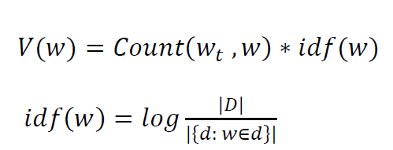
Step1: Obtain Initial Positive Examples
We use two words to do keyword search. Given a topic keyword w_{t} , we need to find the most related word.
We choose w with highest rank score as the second keyword
V(w) : related score of word w
Count(w_{t},w) : document count that w_{t} and w co-occur
d : a document in corpora D
idf(w) : inverse document frequency of word w in D.

Slide 75
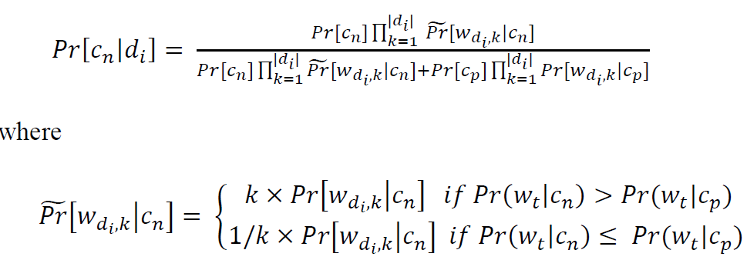
A New PU Learning Algorithm (A-EM)
Like S-EM, A-EM is based on NB classifier and EM to classify documents iteratively. However, it adjusts word probability in NB ( reduce NB bias on positive class)
k tries to increase the word probability for the negative class to deal with underestimation. In order to prevent the NB classifier from “pulling” positive examples into the negative side, we also lower the negative class probabilities of those words that are likely to be good for the positive class. k is adjustable in EM iterations.

Slide 76
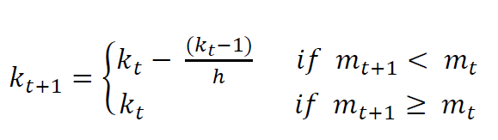
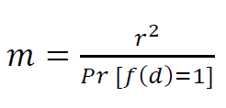
Tuning k Using a Performance Measure
We tune K by a performance measure.
Decaying factor: 3 in our case
Performance measure (similar to F-Score) (Lee and Liu,2003)
Pr(f(d)=1) is the probability that document d is classified as positive, and r is recall. Pr(f(d) =1) and r can be estimated using a validation set randomly drawn from the automatically retrieved positive example set
Notes:
we cannot use the traditional precision, recall and F-score to compute the classification accuracy. Fortunately, this problem has been studied before in by Lee and Liu (2003). They proposed a measure which behaves similarly to F-score,

Slide 77
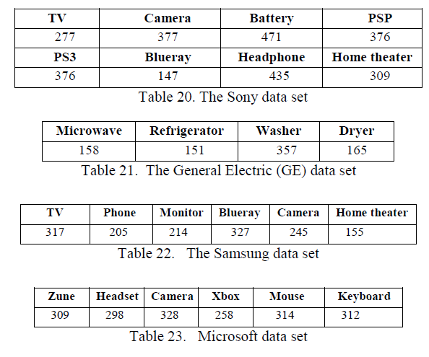
Experiments (data sets)

Slide 78
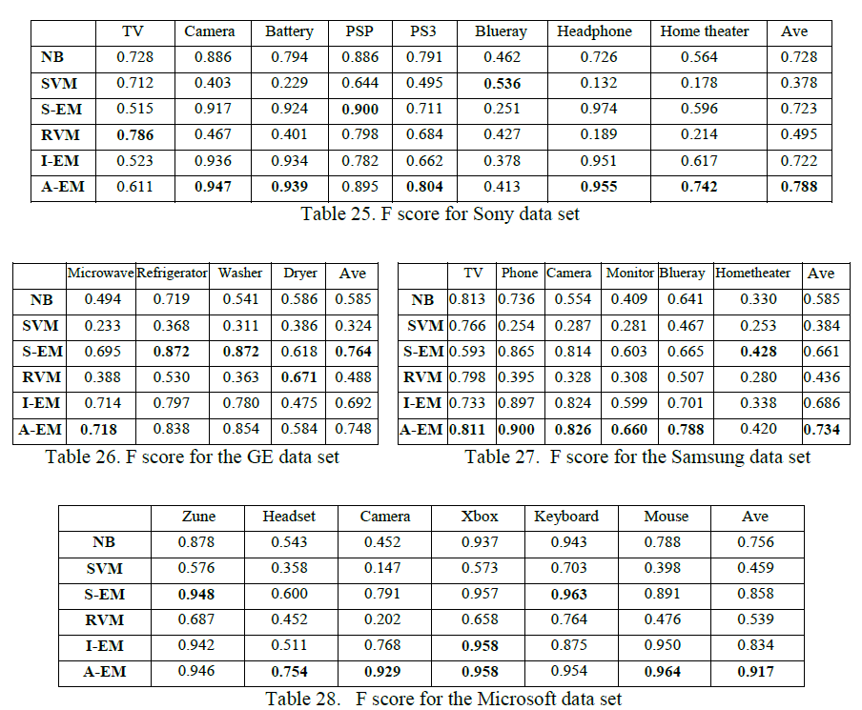
Experiments (results)
A-EM is better than all other baseline PU learning methods including S-EM

Slide 79
Future Work
(1) Extracting and mapping implicit aspects that are verbs or verb phrases.
Many verbs or verb phrases can indicate implicit product aspects in opinion documents. For example, the sentence “The refrigerator does not produce ice”. The sentence expresses a negative opinion on the implicit aspect “ice function” of the refrigerator.
(2) Grouping extracted entities
We find that for the same entity in opinion documents, people may express it with many different words or phrases. For example, both “Mot phone” and “Moto phone” refer to the same entity “Motorola phone”.

Slide 80
Publications
Bing Liu, Lei Zhang. "A Survey of Opinion Mining and Sentiment Analysis". Book chapter in Mining Text Data : 415-463, Kluwer Academic Publishers 2012.
Lei Zhang, Bing Liu. "Extracting Resource Terms for Sentiment Analysis". In Proceeding of the 5th International Joint Conference on Natural Language Processing (IJCNLP 2011): 1171-1179.
Lei Zhang, Bing Liu. "Identifying Noun Product Features that Imply Opinions". In Proceeding of the 49th Annual Meeting of the Association for Computational Linguistics (ACL 2011): 575-580.
Zhongwu Zhai, Bing Liu, Lei Zhang, Hua Xu, Peifa Jia. "Identifying Evaluative Sentences in Online Discussions" In Proceedings of 25th National Conference on Artificial Intelligence (AAAI 2011): 933-938.
Malu Castellanos, Umeshwar Dayal, Meichun Hsu, Riddhiman Ghosh, Mohamed Dekhil, Yue Lu, Lei Zhang, Mark Schreiman. "LCI : A Social Channel Analysis Platform for Live Customer Intelligence" In Proceedings of the 2011 ACM SIGMOD/PODS Conference (SIGMOD 2011):1049-1058.
Lei Zhang, Bing Liu. "Entity Set Expansion in Opinion Documents". In Proceedings of the 22nd ACM Conference on Hypertext and Hypermedia (HT 2011): 281-290.
Malu Castellanos, Riddhiman Ghosh, Yue Lu, Lei Zhang, Perla Ruiz, Mohamed Dekhil, Umeshwar Dayal,Meichun Hsu. "LivePulse: Tapping Social Media for Sentiments in Real-Time", In Proceedings of the 20th World Wide Web Conference (WWW 2011): 193-196.

Slide 81
Publications (continue)
Lei Zhang, Bing Liu, Suk Hwan Lim, Eamonn O'Brien-Strain. "Extracting and Ranking Product Features in Opinion Documents", In Proceedings of the 23rd International Conference on Computational Linguistics (COLING 2010): 757-765.
Xiaoli Li, Lei Zhang, Bing Liu, See-Kiong Ng. "Distributional Similarity vs. PU Learning for Entity Set Expansion", In Proceedings of the 48th Annual Meeting of the Association for Computational Linguistics (ACL 2010): 359-364.
Xiaowen Ding, Bing Liu, Lei Zhang. "Entity Discovery and Assignment for Opinion Mining Applications", In Proceedings of ACM SIGKDD International Conference on Knowledge Discovery and Data Mining (KDD 2009): 1125-1134.
Lei Zhang, Bing Liu, Jeffrey Benkler, Chi Zhou. "Finding Actionable Knowledge via Automated Comparison", In Proceedings of International Conference on Data Engineering (ICDE 2009): 1419-1430.

Slide 82
Thank You
&
Questions ?

